Slide 1
WALMART SALES REPORT
WITH SQL & POWER BI
MOHD SHADAB ALAM
DATA ANALYST INTERN

Slide 2
PROJECT OVERVIEW
Objective:
The primary aim of this project is to analyze Walmart’s sales data using SQL to uncover patterns and trends that can help make informed business decisions.
Scope of Analysis:
Branch Performance: Analyzing sales by branches to identify top-performing locations.
Product Line Insights: Evaluating sales across different product lines.
Customer Payment Preferences: Understanding which payment methods are most popular.
City-Wise Performance: Assessing gross income by city.
Customer Behavior: Identifying purchase patterns, including high-value transactions and frequent customers.

Slide 3
DATA OVERVIEW
Dataset Description:
The dataset consists of sales records including information on branches, product lines, payment methods, customer ratings, date, time, quantity sold, unit price, gross income, and cost of goods sold (COGS).
Key Columns
Branch: Identifies the store where the sale occurred.
Product Line: Categorizes the type of product sold.
Payment Method: Indicates how the customer paid (Cash, Credit Card, etc.).
Gross Income: Calculated as the difference between total sales and COGS.
Date and Time: Timestamp for when the sale was made.

Slide 4
ANALYSIS APPROACH
Methodology:
SQL queries were employed to extract, filter, and aggregate data.
Focus on answering key business questions such as which branches or product lines are performing well, and how customer behavior varies across different segments.
Tools:
SQL was the primary tool used for data analysis.
Data visualizations were created using Microsoft SQL Server to illustrate key findings.

Slide 5
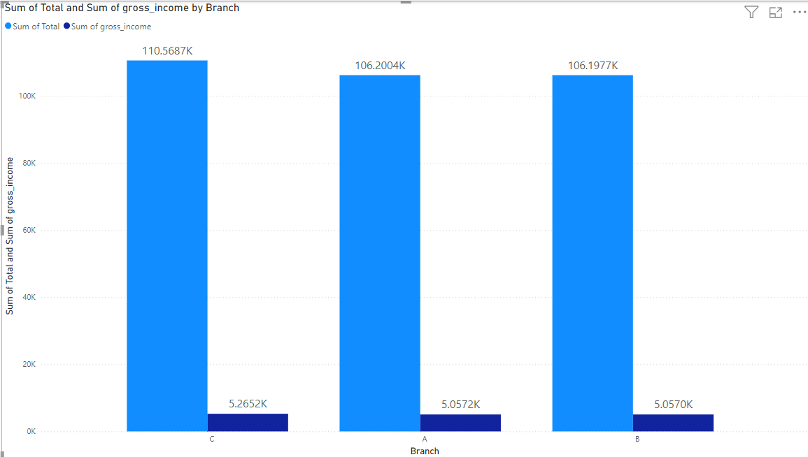
KEY ANALYSIS - BRANCH PERFORMANCE
Title: Sales by Branch
Analysis:
Query: SELECT branch, SUM(total) AS total_sales, SUM(gross_income) AS total_gross_income FROM WalmartData GROUP BY branch;
Result: Displays total sales and gross income for each branch.
Visualization:
Bar Chart: Comparing total sales and gross income across different branches.
Insight:
Branch A and B have the highest sales and gross income, indicating strong performance.
This data can guide decisions on resource allocation and marketing focus for top-performing branches.

Slide 6
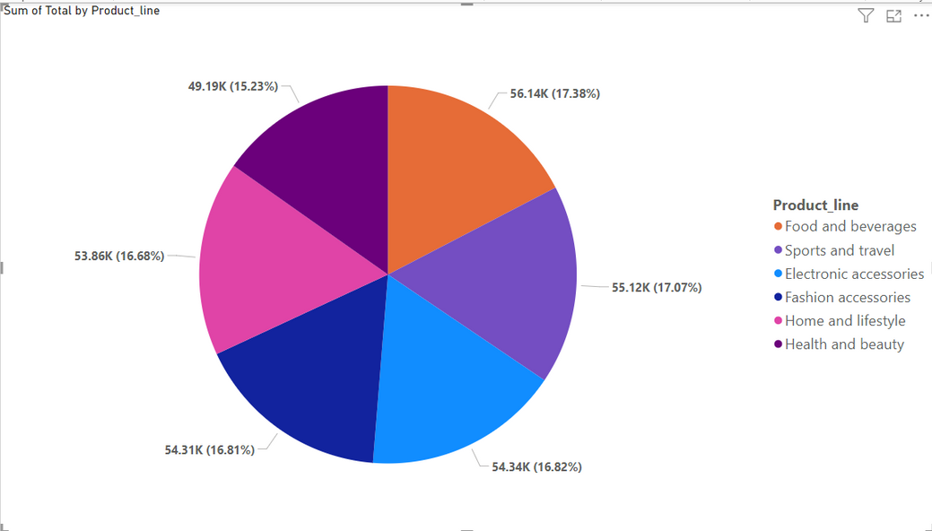
KEY ANALYSIS - PRODUCT LINE PERFORMANCE
Title: Total Sales by Product Line
Visualization:
Pie Chart or Bar Chart: Showing the proportion of sales each product line contributes.
Insight:
Electronics and Groceries dominate sales, suggesting these categories are key drivers of revenue.
This can influence stocking decisions and promotional strategies.
Analysis:
Query: SELECT product_line, SUM(total) AS total_sales FROM WalmartData GROUP BY product_line;
Result: Summarizes total sales for each product line.

Slide 7
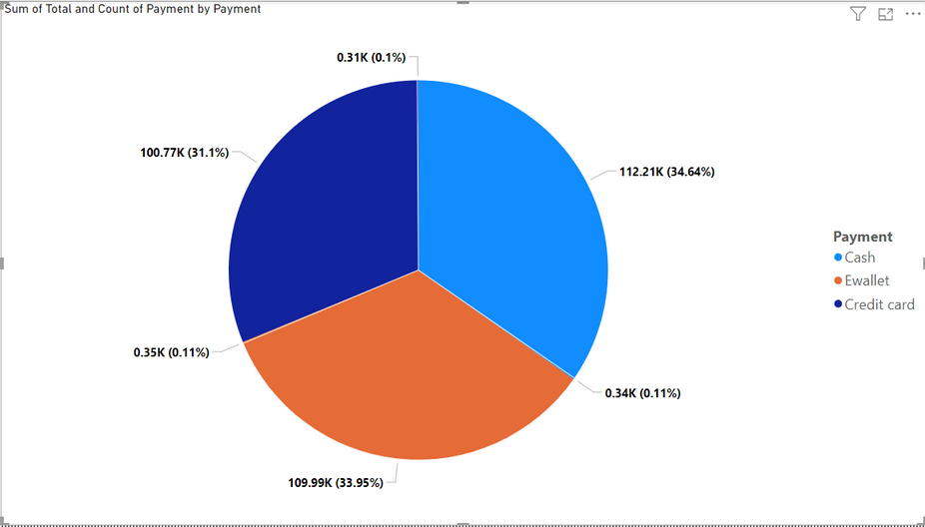
KEY ANALYSIS - CUSTOMER PAYMENT PREFERENCES
TITLE: SALES BY PAYMENT METHOD
Visualization:
Pie Chart: Showing the percentage of transactions made with each payment method.
Insight:
Cash and Credit Card payments are the most common, indicating a potential area for loyalty programs or payment method promotions.
Analysis:
Query:
SELECT payment, COUNT(*) AS num_transactions, SUM(total) AS total_sales FROM WalmartData GROUP BY payment;
Result: Breaks down sales transactions and total sales by payment method.

Slide 8
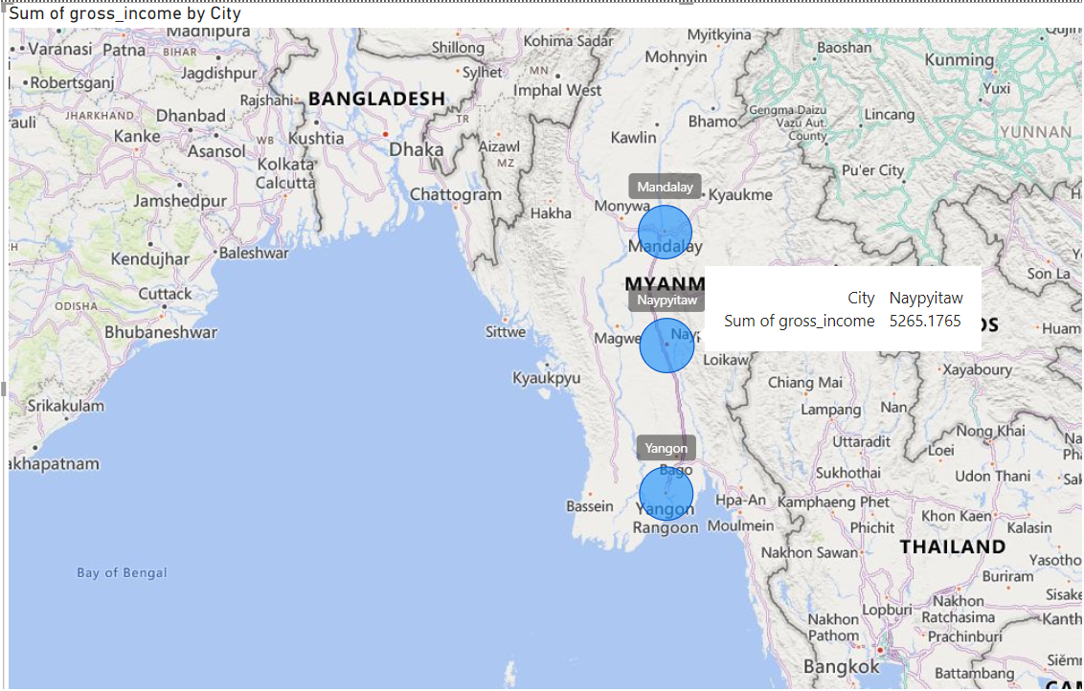
KEY ANALYSIS - GROSS INCOME BY CITY
TITLE: TOTAL GROSS INCOME BY CITY
01
Analysis
Query: SELECT city, SUM(gross_income) AS total_gross_income FROM WalmartData GROUP BY city;
Result: Calculates total gross income for each city.
02
Visualization
Bar Chart or Map: Showing gross income distribution across cities.
03
Insights
Certain cities, like City Naypyitaw and City Mandalay , generate significantly more gross income, which might suggest opportunities for targeted expansion or marketing.

Slide 9
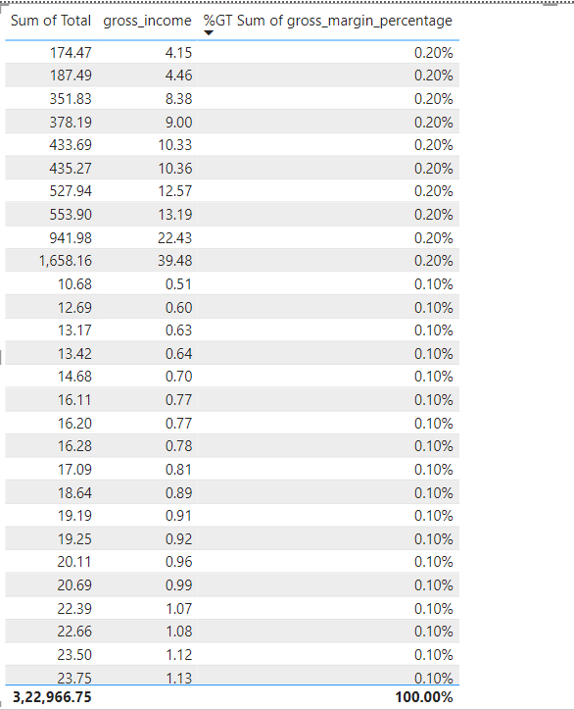
KEY ANALYSIS - HIGH-VALUE TRANSACTIONS
TITLE: TRANSACTIONS WITH HIGH GROSS MARGIN
Visualization:
Table: Highlighting these high-margin transactions.
There is nothing above then 30%
Insight:
These high-margin transactions can be analyzed further to understand what drives profitability and how to replicate these conditions across other sales.
Analysis
Query:
SELECT * FROM WalmartData WHERE gross_margin_percentage > 30;
Result:
Lists transactions where the gross margin percentage exceeds 30%.

Slide 10
INSIGHTS AND RECOMMENDATIONS
Insights
Branch Performance: Branches A and B are the strongest performers, suggesting these locations are well-positioned or have high customer traffic.
Product Line Success: Electronics and Groceries are key contributors to revenue, indicating a focus area for inventory and promotions.
Payment Preferences: Understanding customer payment preferences can lead to optimized payment options and promotions.
City-Wise Performance: Cities X and Y are top gross income generators, presenting opportunities for localized marketing.
Recommendation
Resource Allocation: Invest in marketing and stock management for high-performing branches and product lines.
Promotional Strategies: Develop targeted promotions for high-margin products and popular payment methods.
Geographic Expansion: Consider expanding or increasing focus in top-performing cities.

Slide 11
CONCLUSION AND NEXT STEPS
Conclusion:
The SQL analysis has provided deep insights into Walmart’s sales data, highlighting key areas of strength and opportunities for growth.
These insights can inform strategic decisions to enhance overall business performance.
Next Steps:
Further Analysis: Consider exploring customer segmentation or predictive analytics for future sales trends.
Implementation: Develop actionable plans based on these insights, such as targeted marketing campaigns or product promotions.

Slide 12
SOURCE CODE
https://github.com/mshadabaalam/Mentorness-Internship/tree/main/Walmart%20Sales%20Analysis/SQL%20Source%20Code

Slide 13
QUESTIONS & ANSWERS
Open the floor for questions, allowing you to engage with the findings and ask for clarification or further details.

Slide 14
THANK YOU
27 Aug, 2024

